Slide 1
SECURE DATA HIDING IN IMAGES USING STEGANOGRPHY
SECURE THE DATA TO PREVENT HACKERS
Presented By:
Sanjana Hazare
Malla Reddy University, Computer Science and Engineering

Slide 2
OUTLINE
Problem Statement
Technology used
Wow factor
End users
Result
Conclusion
Git-hub Link
Future scope

Slide 3
Problem Statement
In today's digital world, securing sensitive information from unauthorized access is a critical challenge. Traditional encryption techniques, while effective, often leave visible traces that can attract unwanted attention. Steganography offers a more covert approach by embedding secret messages within multimedia files, making the communication undetectable. This project, "Secure Data Hiding in Image Using Steganography," focuses on developing a system that allows users to hide a secret message inside an image by modifying pixel values while maintaining the image's visual integrity.

Slide 4
Technology used
Libraries:
The project utilizes OpenCV for image processing, os for file handling, and string for character manipulation.
It also employs Python’s built-in dictionary for ASCII mapping and message encoding.
These libraries collectively enable efficient image-based steganography and secure message retrieval.
Platforms Used:
IDLE Shell 3.12.2
Stego.py
OpenStego

Slide 5
Wow factors
This project stands out due to its simple yet effective pixel-level steganography approach directly
embedding ASCII values into image pixels without significantly altering the visual appearance.
Unlike many steganography methods that use complex transformations or external encryption
libraries, this project leverages direct pixel manipulation with OpenCV, making it lightweight and efficient.
Additionally, the inclusion of a passcode-based authentication system ensures an added layer of security,
restricting unauthorized access to the hidden message. The use of all three RGB channels for encoding
further enhances data concealment while maintaining image quality. This minimalistic yet functional approach
makes the project unique offering a balance between security, simplicity, and computational efficiency.

Slide 6
End users
The project "Secure Data Hiding in Image Using Steganography" can benefit a variety of real-time users,
including government agencies and military organizations that require secure communication of sensitive
or classified data. It can also serve cybersecurity professionals and corporations who need to protect
intellectual property or confidential information. Additionally, journalists and activists working in restrictive
regions can use it to safely transmit data without fear of detection or censorship. Personal users seeking
secure ways to exchange private information and digital forensics teams investigating hidden data in digital
media would also find this technology valuable. Overall, the project addresses the growing need for discreet
and secure data transmission in various sectors.

Slide 7
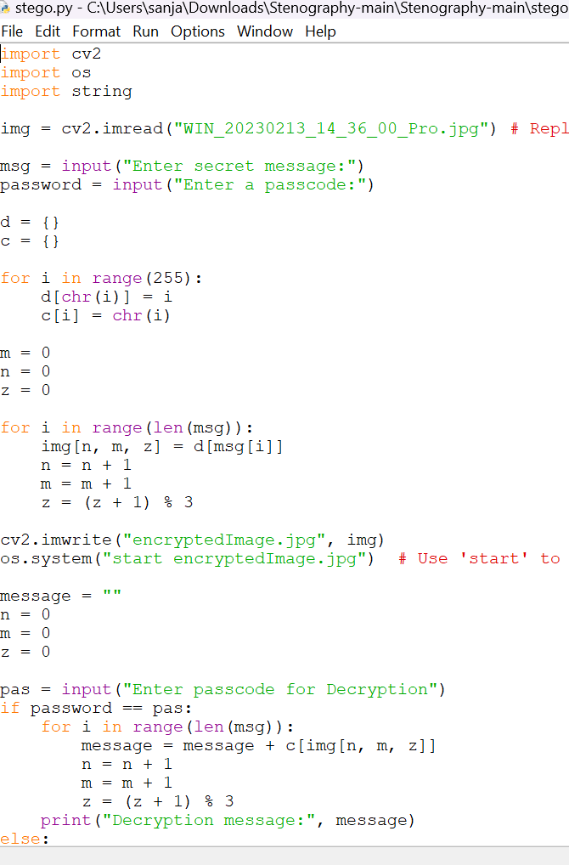
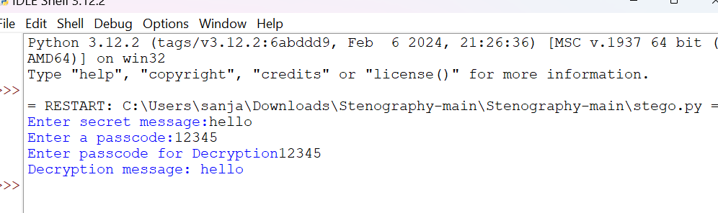
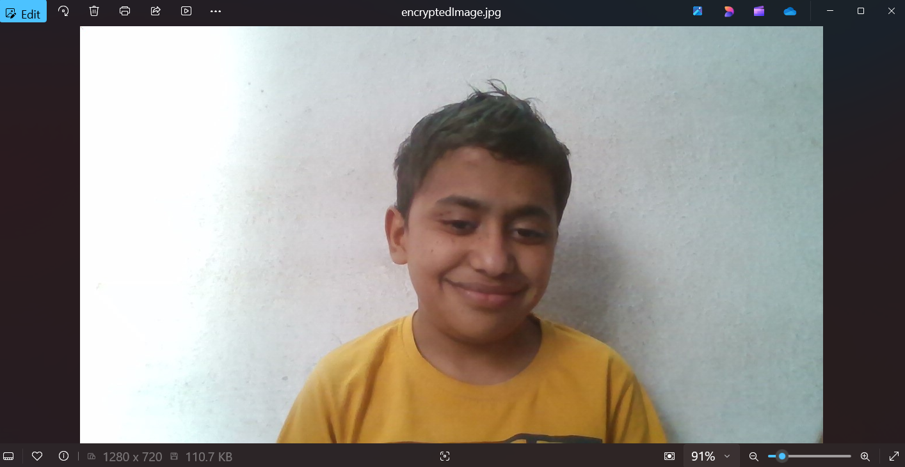
Results

Slide 8
Conclusion
In conclusion, the project "Secure Data Hiding in Image Using Steganography" addresses the critical
problem of protecting sensitive information in a digital age where privacy and security are paramount. By
embedding data within seemingly harmless images, it ensures that the hidden information remains undetectable
to unauthorized parties, thus mitigating the risks of data interception and unauthorized access.
This approach not only enhances security for communication across various sectors—such as government,
military, corporate, and personal use—but also offers a practical solution to maintaining confidentiality in an
increasingly connected world. The project's effectiveness in providing both security and discretion establishes
it as a valuable tool in safeguarding sensitive data against potential threats.

Slide 9
GitHub Link
https://github.com/Sanjana-jpg454/AICTE-project.git

Slide 10
Future scope(optional)
The future scope of the "Secure Data Hiding in Image Using Steganography" project is promising,
with numerous opportunities for expansion and enhancement. It can incorporate advanced encryption
techniques to further strengthen data security, integrate real-time communication applications,
and extend to other media types like audio, video, and text for broader use cases. Future work could
also explore the development of steganalysis tools for detecting hidden data, as well as leveraging AI
and machine learning to improve the embedding and extraction processes. Additionally, combining
steganography with blockchain could provide a more secure and tamper-proof data storage solution.
The integration of this technology into IoT devices could also offer a new level of privacy and security for
connected systems, highlighting the vast potential for this project to evolve and adapt to emerging needs in
data protection.

Slide 11
THANK YOU

